Slide 1
Internet of Things
IO 4041
Application Layer Protocols

Slide 2
Publish–Subscribe Model: Decoupling
Decoupling of the publisher of the message from the recipient (subscriber)
Dimensions
Space decoupling: Publisher and subscriber do not need to know each other (for example, no exchange of IP address and port).
Time decoupling: Publisher and subscriber do not need to run at the same time.
Synchronization decoupling: Operations on both components do not need to be interrupted during publishing or receiving.

Slide 3
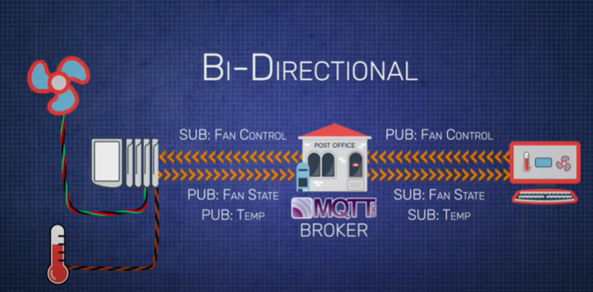
MQTT: Bidirectional

Slide 4
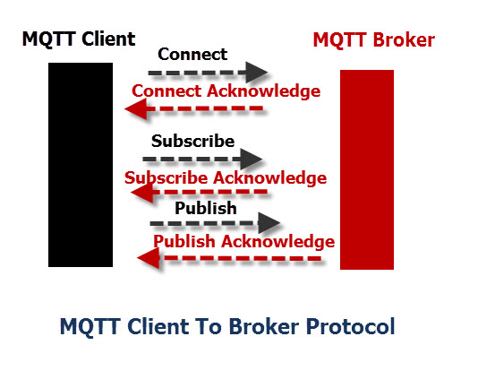
MQTT
MQTT uses a command and command ACK format.
i.e., each command has an associated ACK.

Slide 5
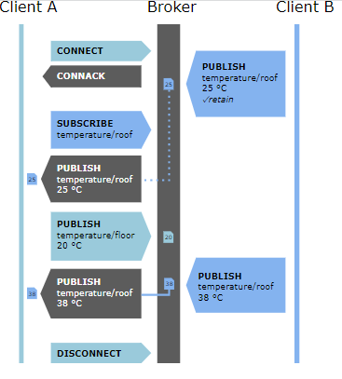
MQTT

Slide 6
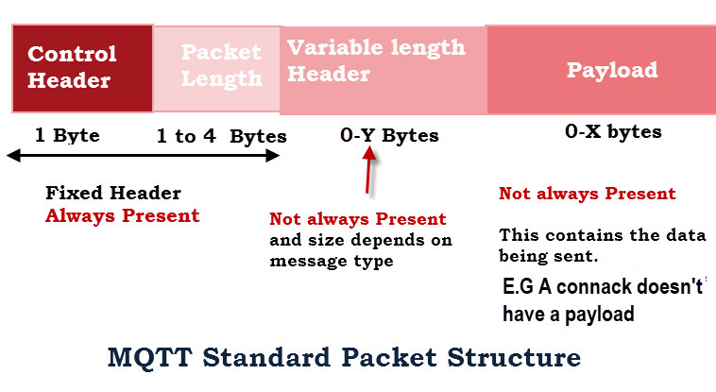
MQTT packet structure

Slide 7
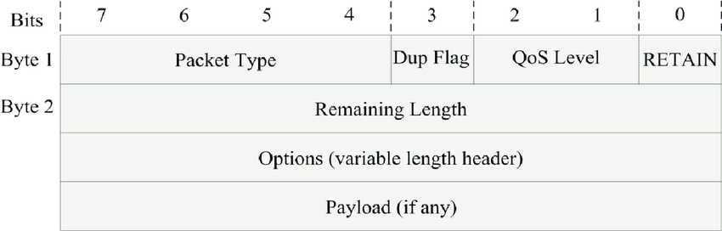
MQTT packet structure

Slide 8
MQTT: Possible packet formats
Fixed Header (Control field + Length)
  Example CONNACK
Fixed Header (Control field + Length) + Variable Header
  Example PUBACK
Fixed Header (Control field + Length) + Variable Header + payload
  Example CONNECT

Slide 9
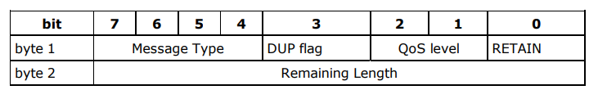
MQTT: Fixed Header

Slide 10
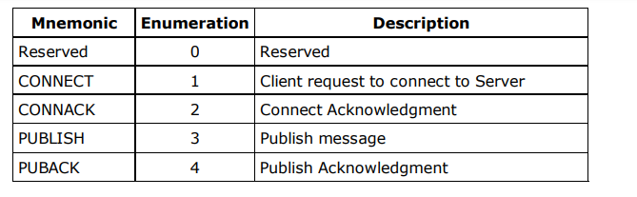
MQTT: Message Type

Slide 11
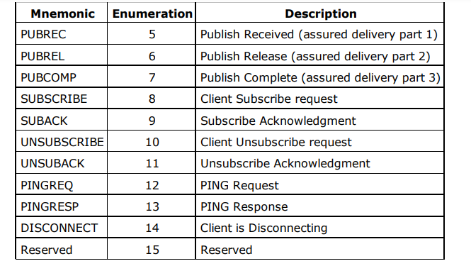
MQTT: Message Type

Slide 12
MQTT: Dup Flag
This flag is set when the client or server attempts to re-deliver a PUBLISH, PUBREL, SUBSCRIBE or UNSUBSCRIBE message.
This applies to messages where the value of QoS is greater than zero (0), and an acknowledgment is required
When the DUP bit is set, the variable header includes a Message ID.
The recipient should treat this flag as a hint as to whether the message may have been previously received. It should not be relied on to detect duplicates.

Slide 13
MQTT: QoS level
QoS levels are a deal within two parties of a message with respect to the assurance for delivery of a PUBLISH message.
There are there level of Quality of Services
QoS0 (At most once ): 00 : <=1
A message is delivered at most once
no acknowledgement of receiving is required
does not provide guarantee delivery of a message

Slide 14
MQTT: QoS level
QoS1 (At least once): 01 : >=1
Every message is delivered at least once
a confirmation of receiving a message is required.
Duplicate may exist in messages (value of DUP flag is set to 1)
QoS2 (highest level : Exactly once):
Message is sent exactly once by using a four-way handshake mechanism
An additional protocol is required in this level to guarantee that the message is delivered only once

Slide 15
MQTT: Retain
This flag is only used on PUBLISH messages.
When a client sends a PUBLISH to a server,
if the Retain flag is set (1),
  the server should hold on to the message after it has been delivered to the current subscribers.
When a new subscription is established on a topic
the last retained message on that topic should be sent to the subscriber with the Retain flag set.
If there is no retained message, nothing is sent

Slide 16
MQTT
Persistent sessions: Broker keeps track of each session and can even store session information long term as devices go on and off line

Slide 17
MQTT: Remaining Length
Byte 2 of fixed header
Represents the number of bytes remaining within the current message, including data in the variable header and the payload.
Encoding scheme for message upto 127 bytes: single byte for messages up to 127 bytes long

Slide 18
MQTT: Remaining Length
Encoding scheme for longer messages: single byte for messages up to 127 bytes long
Seven bits of each byte encode the Remaining Length data, and the eighth bit indicates any following bytes in the representation.
The variable length "extension bytes" are part of the fixed header, not the variable header.

Slide 19
MQTT: Optional header
Many fields like
Protocol name
Protocol version
Connect flags
Username and password flags

Slide 20
MQTT: payload
The following types of MQTT command message have a payload
CONNECT
SUBSCRIBE
SUBACK

Slide 21
Summary
Works mainly as a pipe for binary data and provides a flexibility in communication patterns
A publish-subscribe messaging protocol with most possible minimal bandwidth requirements
Uses TCP for transport
MQTT is an open standard, giving a mechanisms to asynchronous communication,
Have a range of implementations, and it is working on IP.
Widely used protocol
  used by famous corporations. Such as, Amazon and Facebook

Slide 22
MQTT
used in devices with restricted memory capabilities and limited processing power
connects the networks and devices with middleware and applications
This connection uses machine-to server (M2S), server-to-server (S2S), machine-to-machine communication patterns, and
routing mechanism (one-to-many, one-to-one, many-to-many).
most favorable connection protocol for M2M and IoT

Slide 23
MQTT: Broker
The default MQTT port that worked on is TCP/IP port.1883
Has different types, such as, mosquito, hivemq, and paho MQTT
MQTT built on the upper of TCP protocol as the Hypertext Transfer Protocol (HTTP).
However, it is designed to have a less protocol overhead than HTTP
delivers the messages using three QoS levels

